Slide 1



SCAM AWARENESS
IF IT DOESN’T MAKE SENSE OR YOU’RE NOT SURE, HANG UP AND CALL YOUR AREA SUPERVISOR AND DIRECTOR OF OPERATIONS!

Slide 2
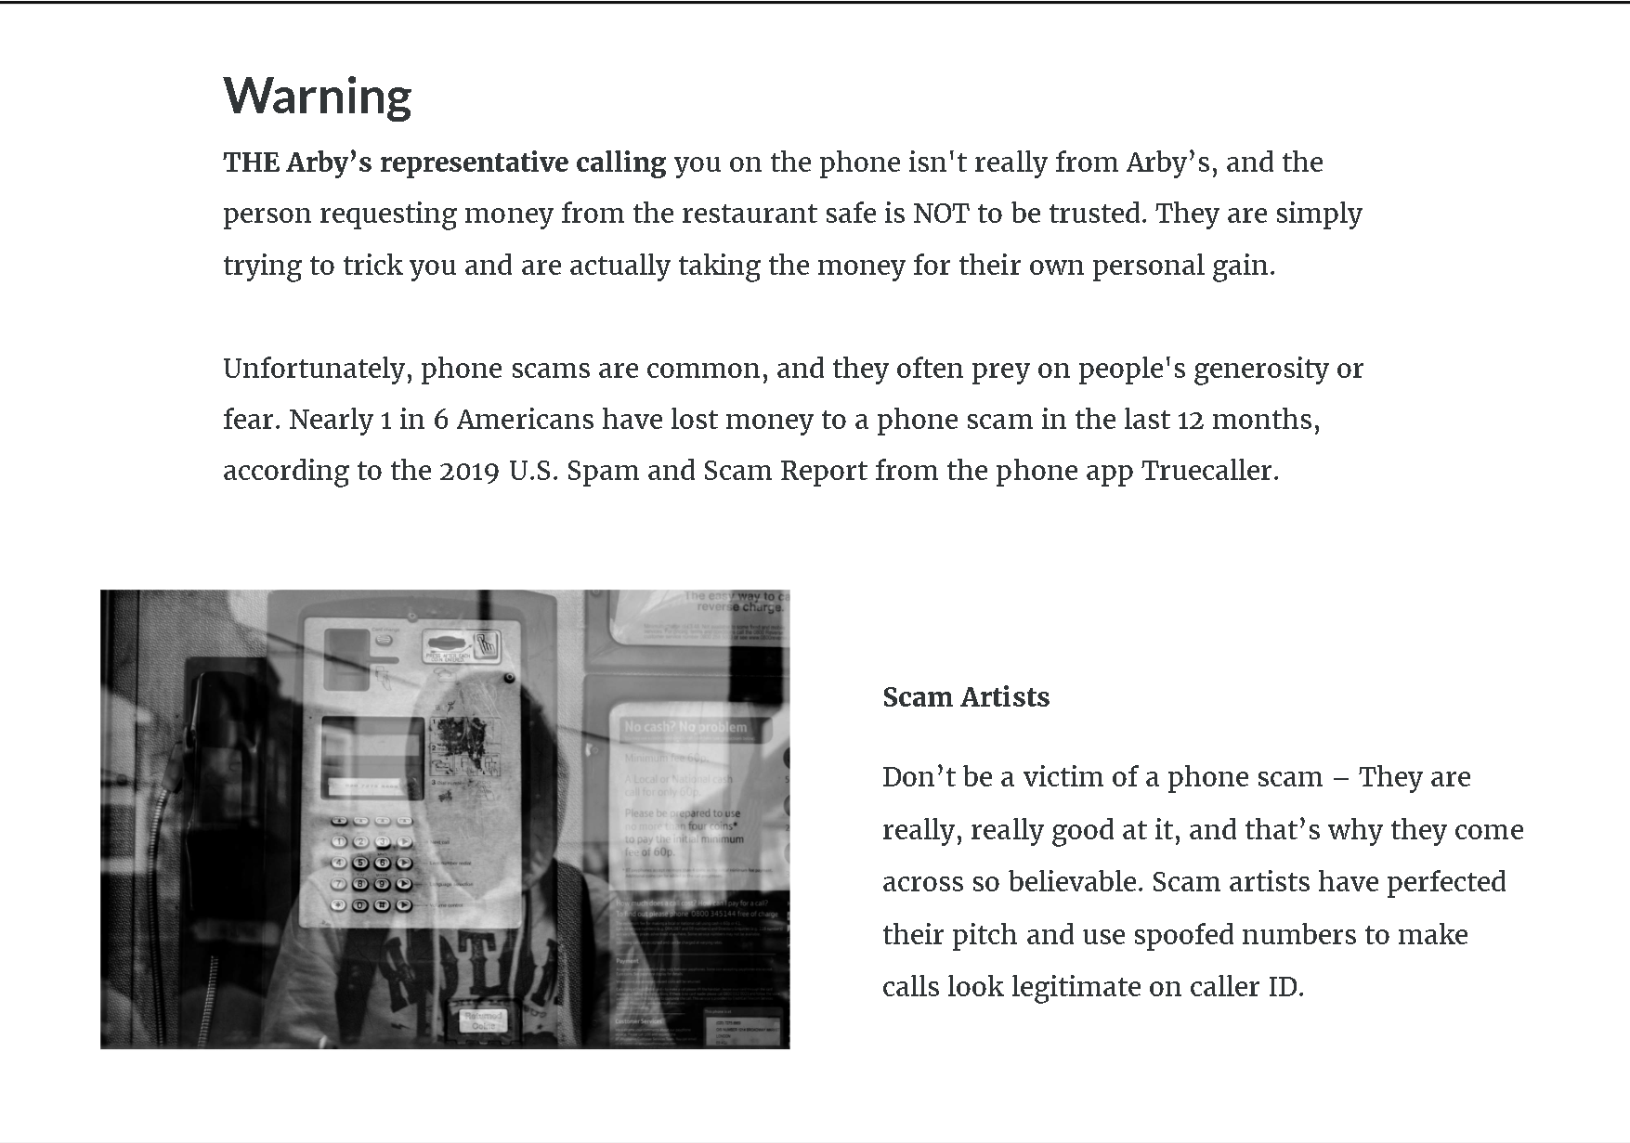

Slide 3
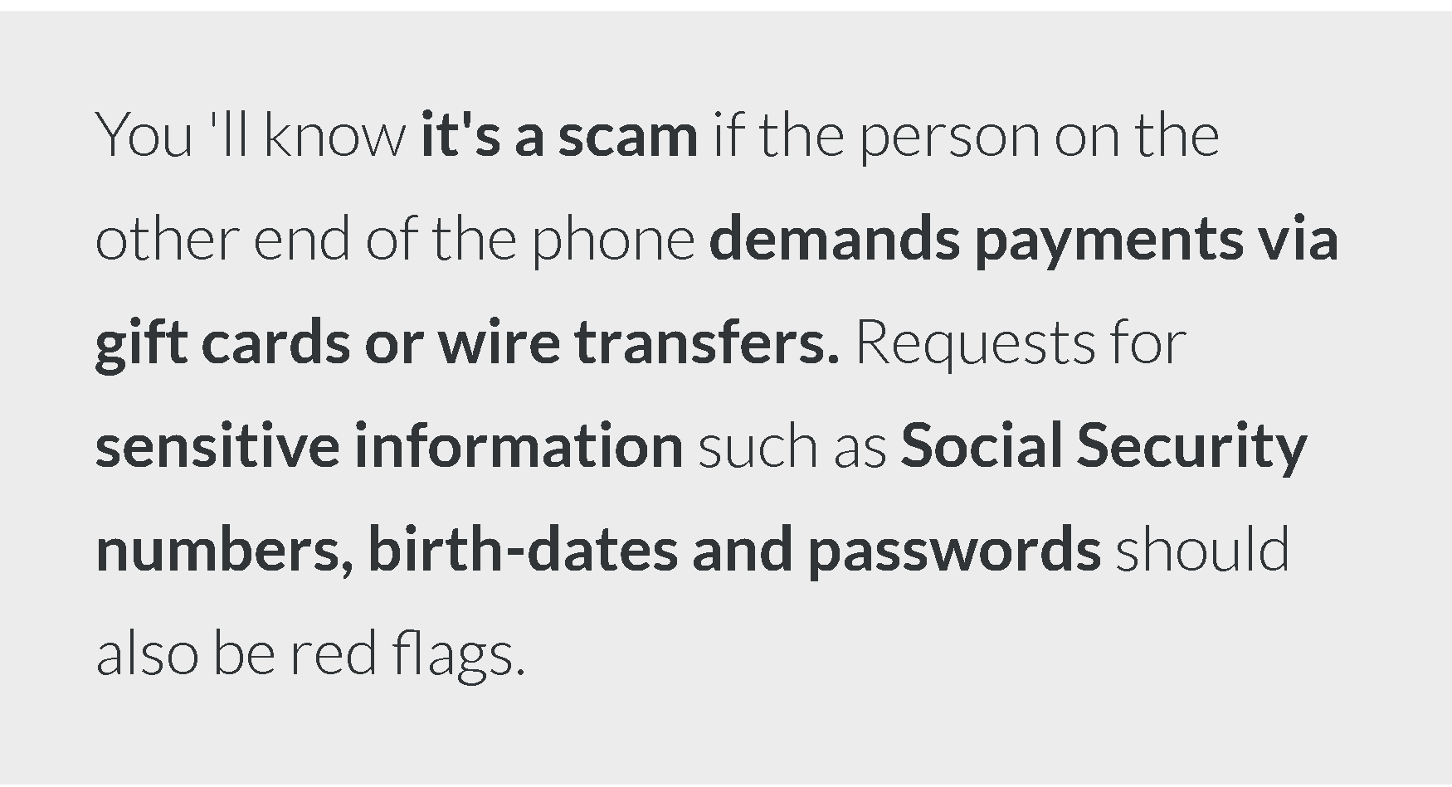

Slide 4
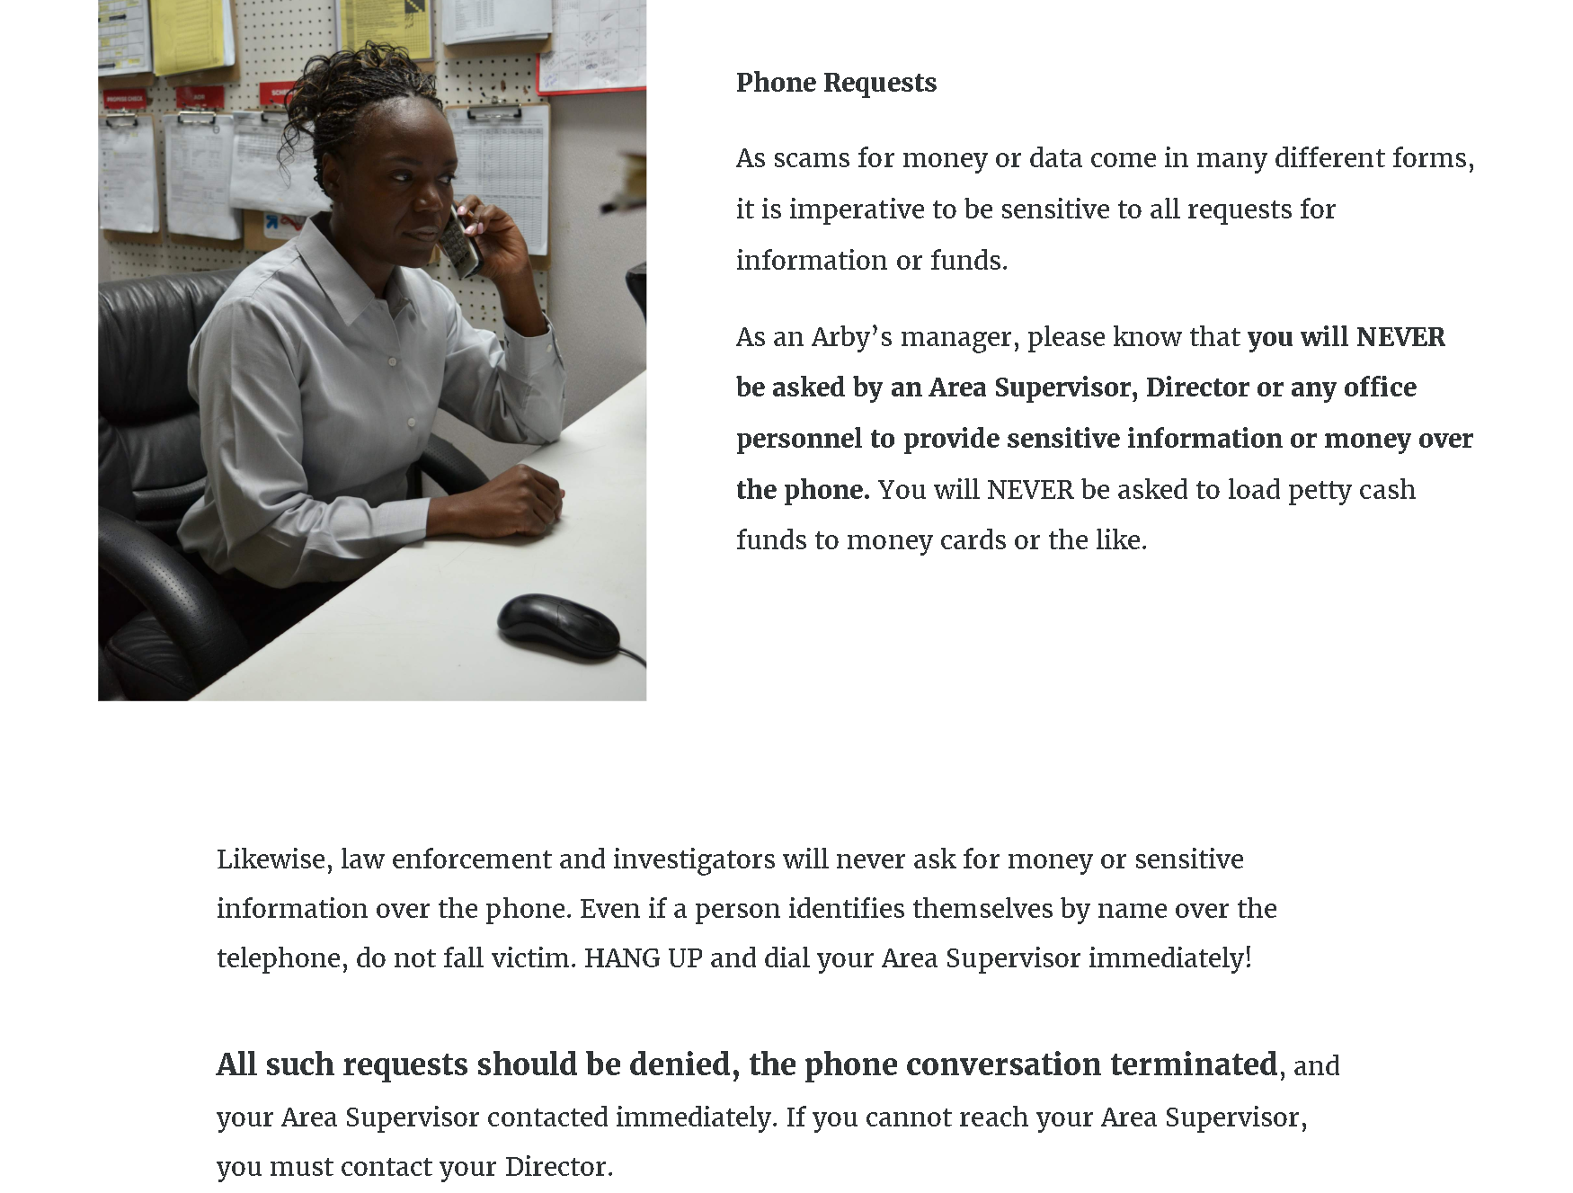

Slide 5



TEST

Slide 6
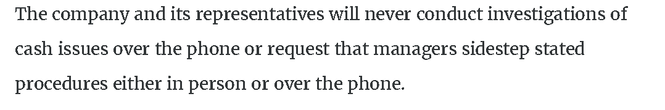
TRUE
This includes credit terminal info

Slide 7
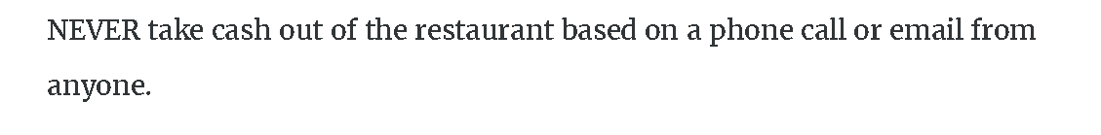
TRUE

Slide 8
are RED FLAGS

Slide 9
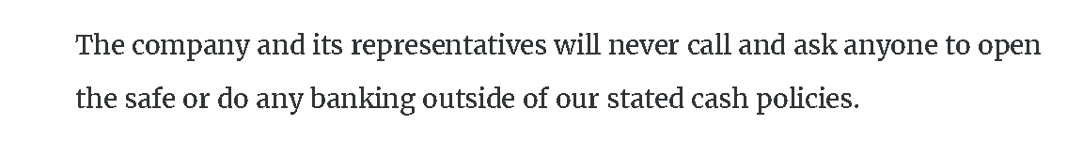
TRUE

Slide 10


