Slide 1

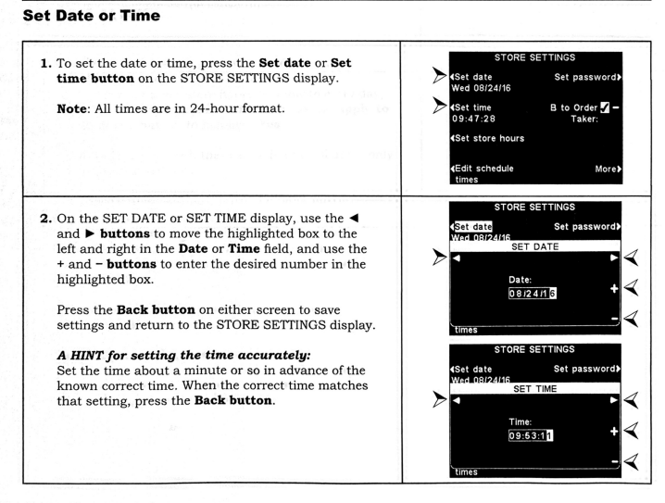
DT Timer Quick Guide
Step 1 Verify your Date and Time settings. If not correct, your recorded messages may tell your customers you are closed during open hours.

Slide 2
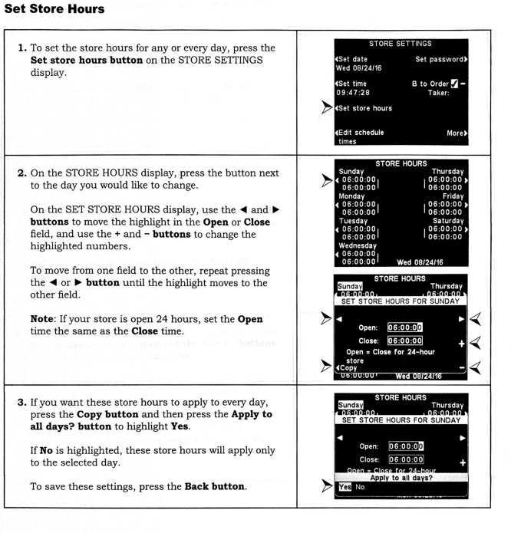
DT Timer Quick Guide
Step 2 Verify your operating hours.

Slide 3
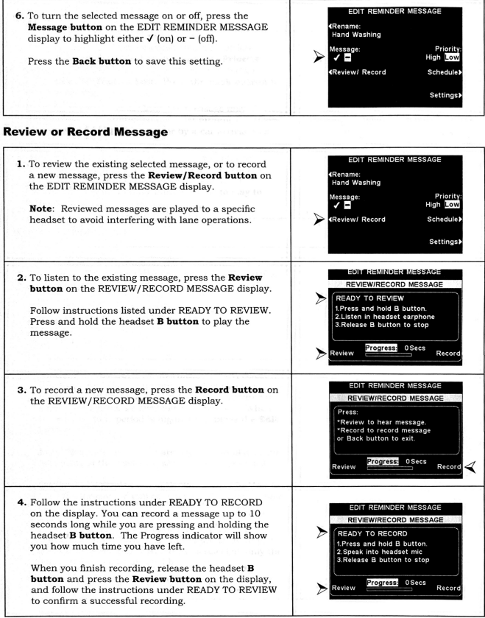
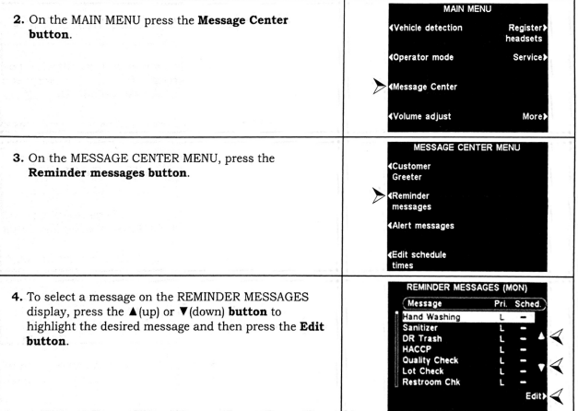
DT Timer Quick Guide
Step 3 Set your Handwashing reminder.

Slide 4
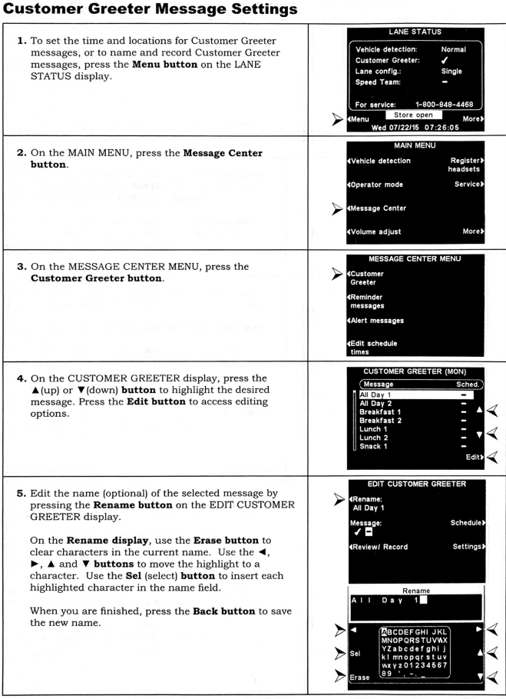
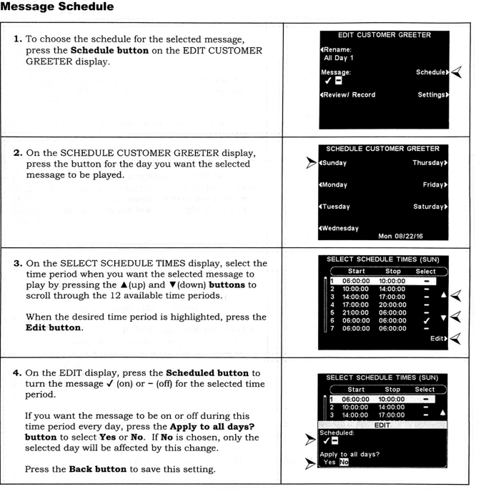
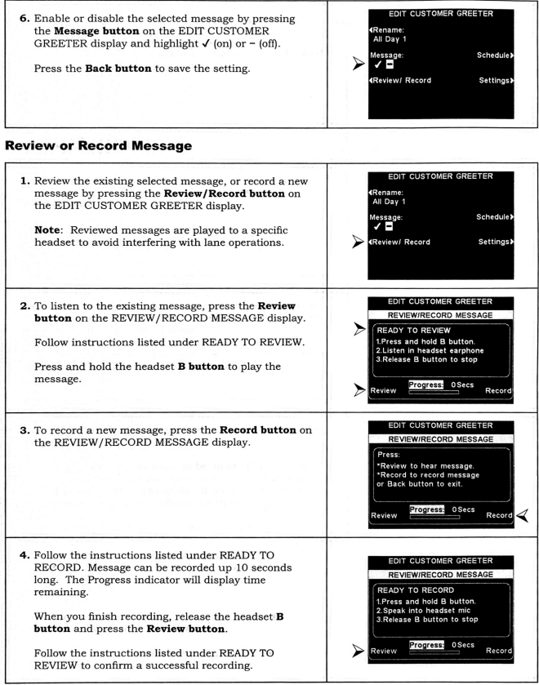
DT Timer Quick Guide
Step 4 Set your auto Greeting
Remember to use the Arby’s script: “Welcome to Arby’s! Please, order when you are ready!”
Make sure there is a smile in the voice!

